Slide 1

Dobby
Project Presentation
Team: TG 03.1 Progi i žohari
Ak. god. 2025./2026.

Slide 2
Content
Team members
About the project
Request review
Architecture
UML use case diagrams
System architecture
ER Database model
Dynamic behavior of Dobby
Testing
Used tools & technologies
Organization of work
Conclusion

Slide 3
Team members
Matija Akrap – Team lead, backend
David Grabovac - Backend
Helena Floreani – Frontend
Fran Kramberger – Frontend, documentation
Nora Milolović - Frontend, design
Luka Volarević – Database, DevOps
Jurica Šlibar – DobbySense
Notes:
Just list no need to elaborate in this stage!

Slide 4
About the project
We are developing a social network for movies and series that combines social interaction with a recommendation system that finds media tailored to users' needs.
Functionalities:
searching for movies and series, rating & reviewing them, commenting on reviews, adding content to personal watchlists
the ability to send messages and recommend content to friends
ML system (DobbySense) that suggests content based on the user’s tastes
Notes:
Navedite samo svoju viziju projektne ideje...

Slide 5
About the project
Similar solutions already exist:
Letterboxd
IMDb
Our advantage:
A recommendation system
Personalised suggestions
Messages, groups, sharing movies & shows
Notes:
Navedite samo svoju viziju projektne ideje...

Slide 6
Request review
Functional requirements:
Signup: user
Functional requirements of the user:
Profile page: basic user information (username, avatar, bio)
Functionalities:
View media: detailed information about movies and TV shows (title, description, genre, poster)
Rate and review content
Follow other users and their activity
View personalized activity feed (friends’ reviews, comments, recommendations)
Send and receive messages from other users
Technical Functionalities:
Registration via OAuth 2.0 (Google)
Media recommendation: system uses content-based and collaborative filtering
Integration with external API (TMDB) for movie and TV show data
Frontend: Next.js (React)
Backend: Next.js API + PostgreSQL database
Recommendation engine implemented Responsive design and support for concurrent users

Slide 7
Request review
Non-Functional requirements:
Design and User Experience (UI/UX)
App responsiveness, adapted to all devices
Component consistency
Security and Reliability
OAuth 2.0
Performance and Efficiency
Caching recommended movies
Reduced API fetching
Optimizing web loading
Publicly available and concurrently accessible by multiple users
DobbySense:
Making the recommendations as favourable as possible to the individual person.
Making it fast and reliable.

Slide 8
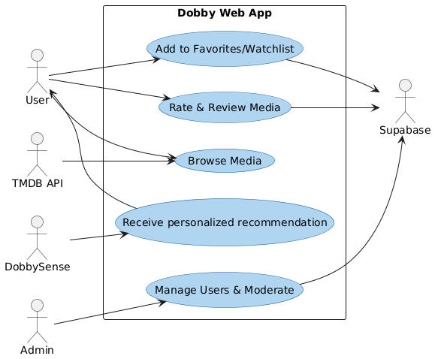
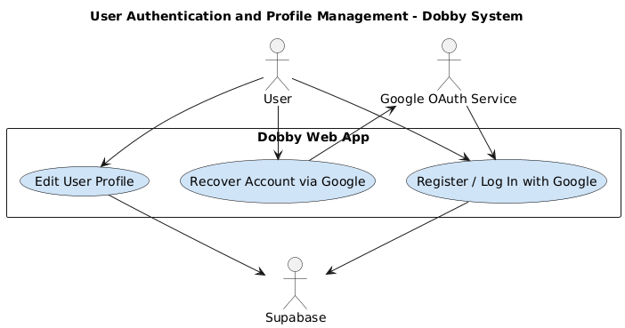
UML use case diagrams

Slide 9
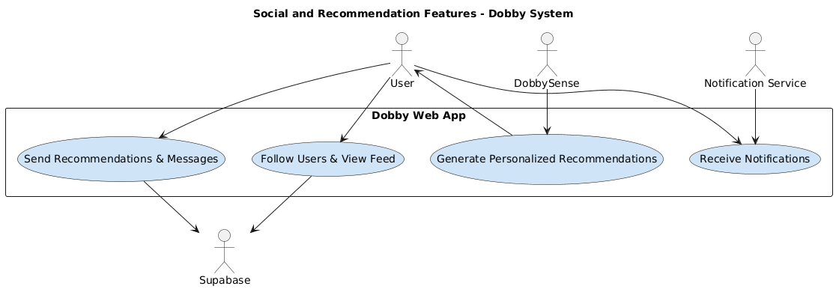
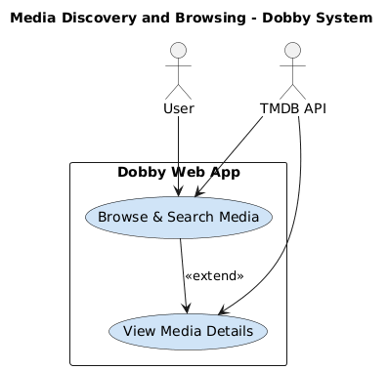
UML use case diagrams

Slide 10
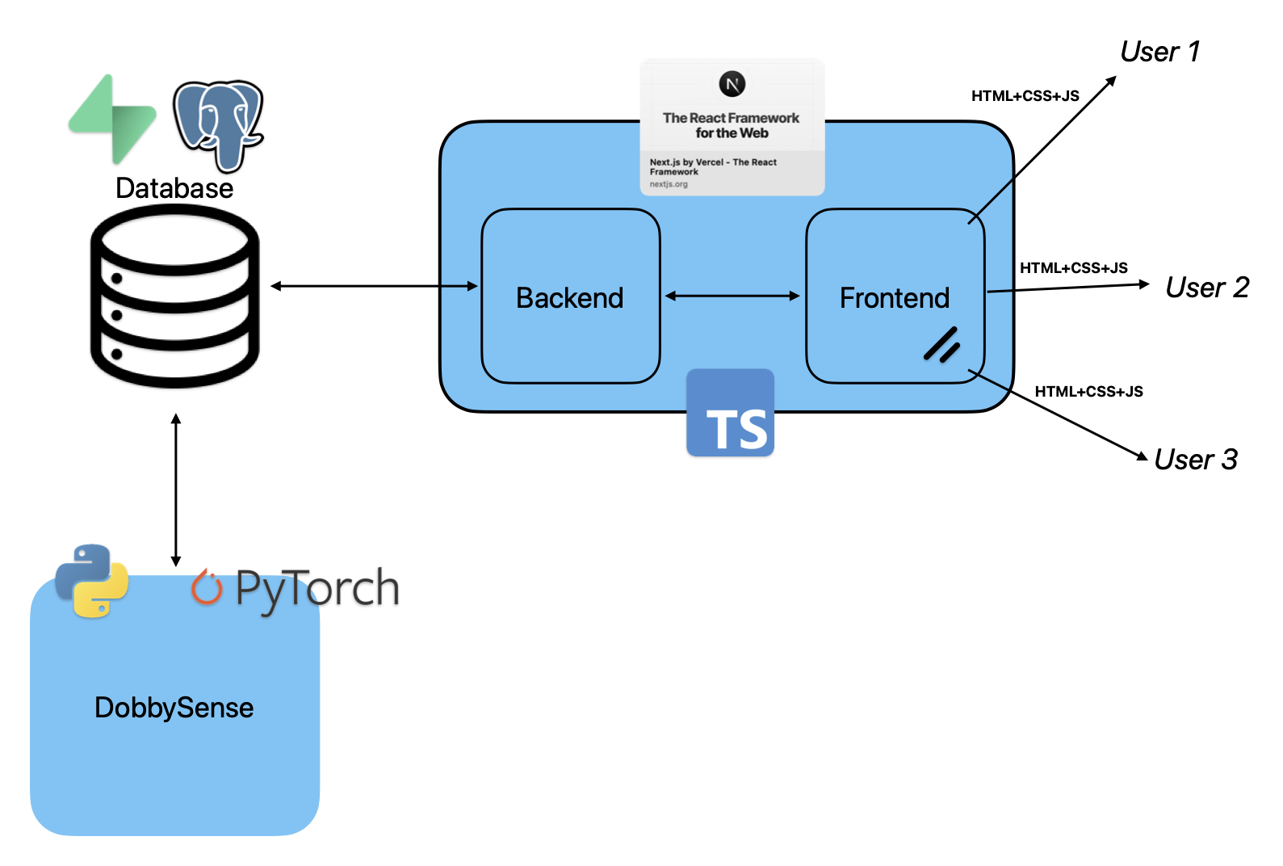
System architecture
2nd version

Slide 11
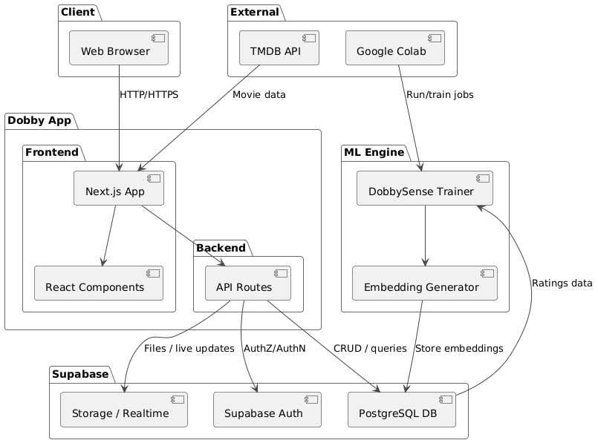
System architecture

Slide 12
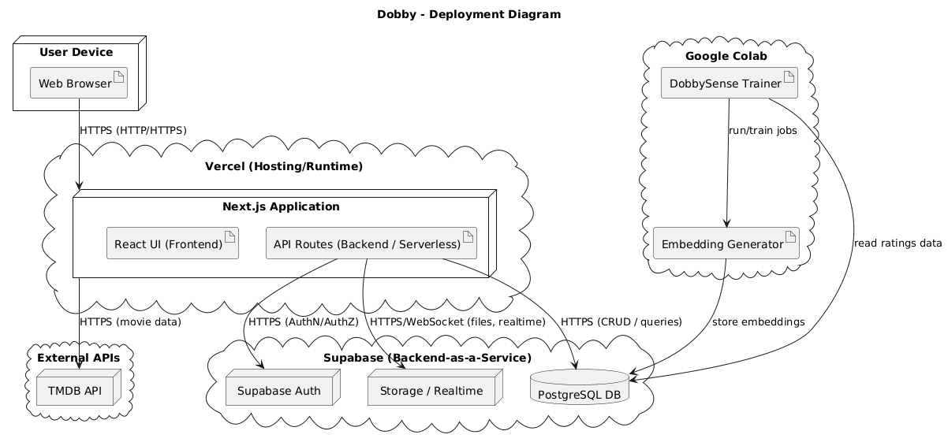
System architecture

Slide 13
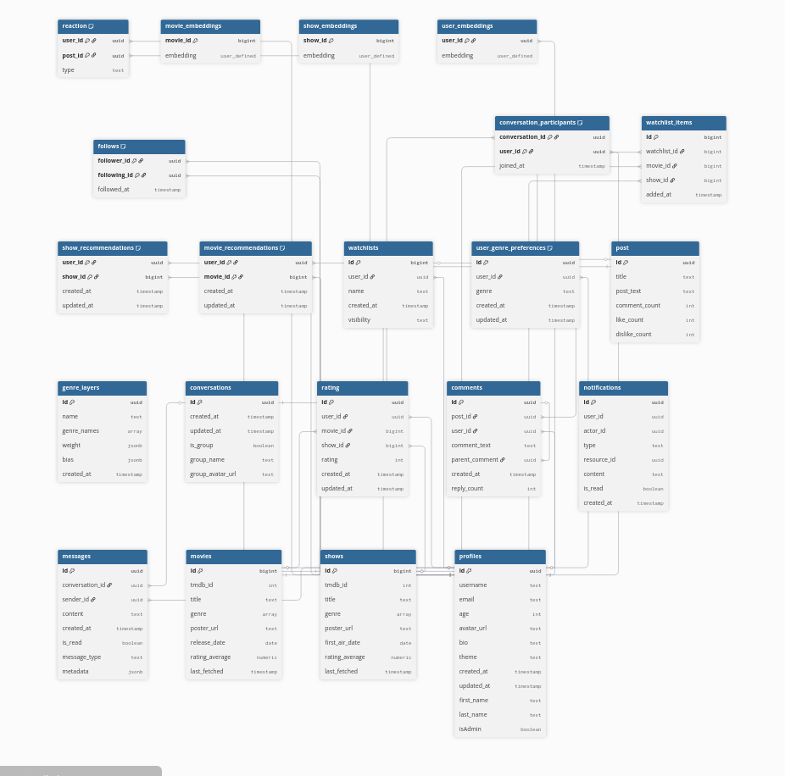
ER database model

Slide 14
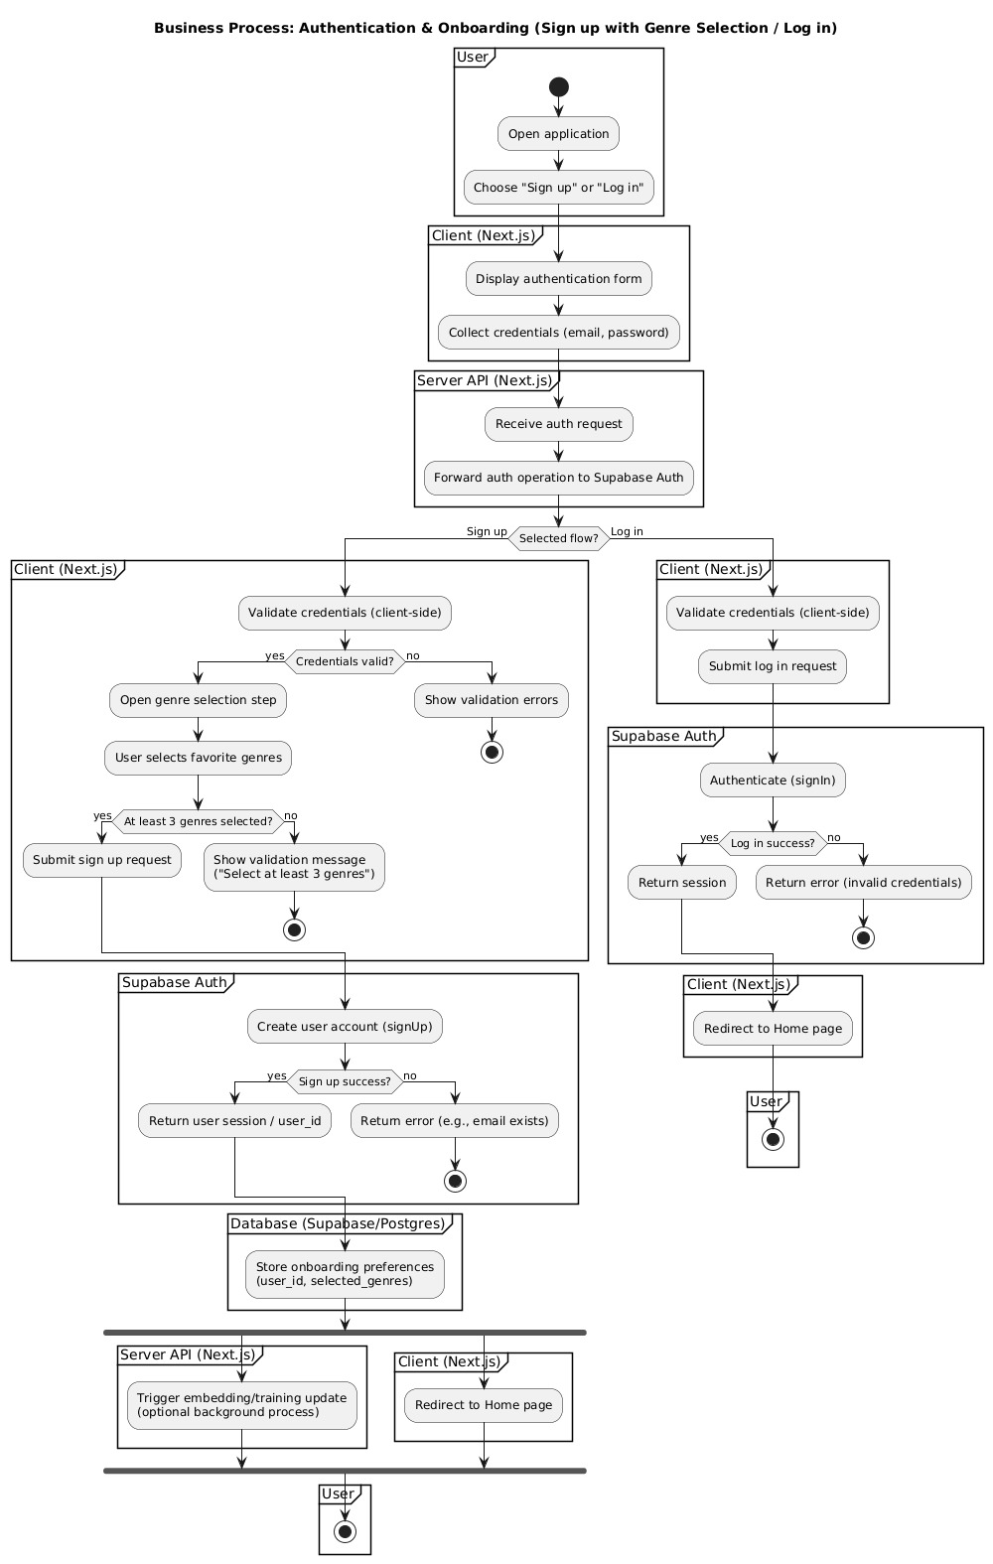
Dynamic behavior of dobby

Slide 15
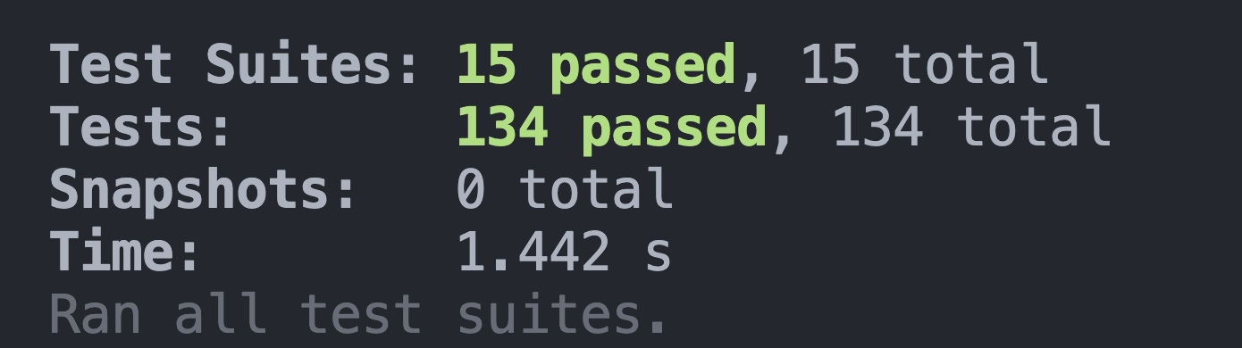
Testing
Testing made with Jest package
Testing most used components and most used APIs

Slide 16
Used tools & technologies
Team communication: Discord, Whatsapp
UML diagram tools: PlantUML
Main programming language: TypeScript
Frontend: Next.js 15, React 19, Tailwind CSS, shadcn/ui
Backend: Next.js 15
Database: Supabase, PostgreSQL
Version control: Git 2.52.0
Testing: Jest, React Testing Library
Machine learning: Python, Pytorch, Scikit-learn, Google Colab, Pandas
Deployment: Vercel

Slide 17
Organization of work
Non-program (organizational) tasks
Communication: in-person meetings, Discord, Whatsapp
Source control with Git: challenges(learning it, merge conflicts, pull requests…)
Spiral model of Software Development
Development timeline
Around 15 weeks
First phase: project documentation, defining functional tasks, researching, designing the architecture, creating an app template, implementing the most basic functions
Second phase: implementing all the other advanced functionalities, finishing the DobbySense pipeline, testing the app, debugging, documenting

Slide 18
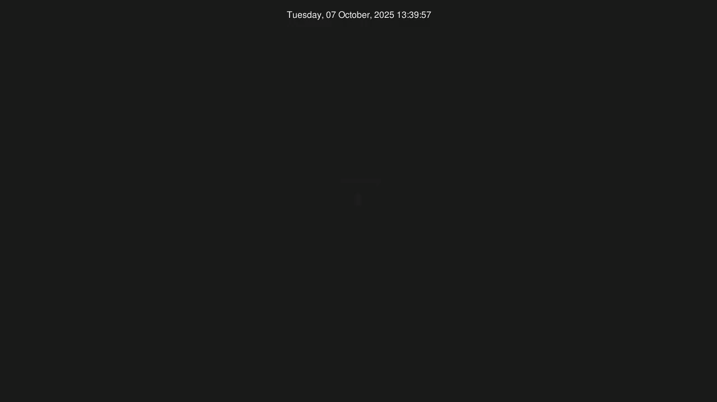
Organization of work
Tool used: Gource

Slide 19
Conclusion
Experiences & learned lessons!
Overall:
Communication and teamwork is the most important.
Things don’t go as planned, so you have to rollback, find a new way and reiterate.
Challenge working with new technologies and with people with different experience levels.
Possible updates with new features for the social aspect of the app.
DobbySense:
Built a whole recommendation system pipeline.
The perfect recommendation system continuously takes users’ ratings and adjusts suggestions. However, this is very compute intensive and requires a lot of resources, e.g. a lot of GPUs.
Could scale and reanalyze & reiterate to make the model better.
P.S. Don’t merge features at 2AM.

